Slide 1
Matrix multiplication

Slide 2
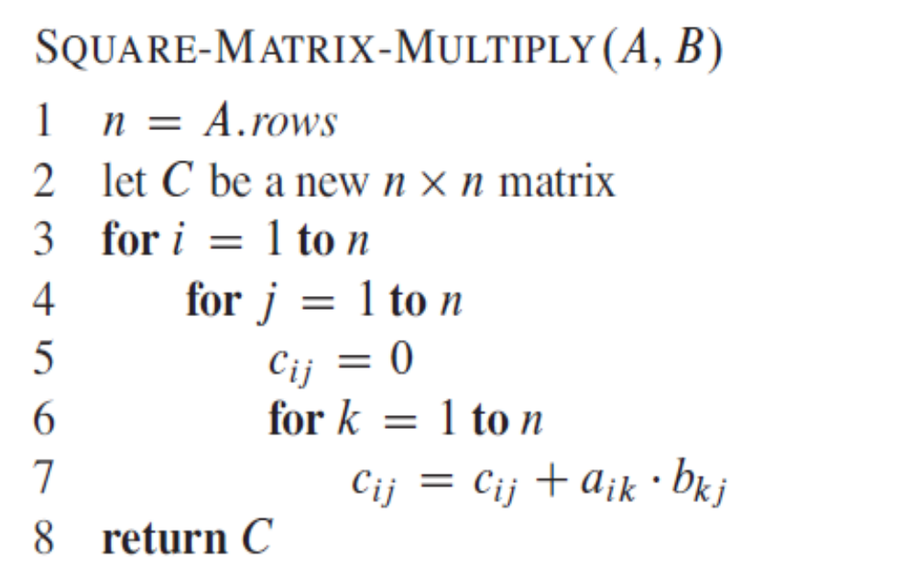
Shortest paths and matrix multiplication
Developing a ϴ(V⁴)-time algorithm for the all-pairs shortest-paths problem and
then improve its running time to ϴ(V³ lgV ).

Slide 3
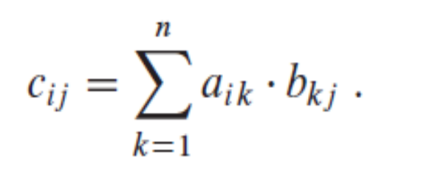
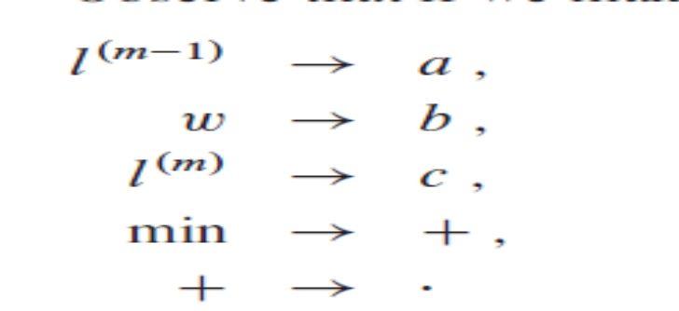
Replace by zero and

